Slide 1

CS-M151B
Computer Systems Architecture
Blaise Tine
UCLA Computer Science

Slide 2

Attendance

Slide 3
Agenda
Control Hazards
Project #1

Slide 4
Control Hazards: Speculation
Practical Branch stats
About 20% of instructions is control-flow
50% of forward branches (if-then-else) are taken
90% of backward branches (loops) are taken
30% of all branches are not-taken

Slide 5
Control Hazards: Speculation
Practical Branch stats
About 20% of instructions is control-flow
50% of forward branches (if-then-else) are taken
90% of backward branches (loops) are taken
30% of all branches are not-taken

Slide 6
Control Hazards: Speculation
Practical Branch stats
About 20% of instructions is control-flow
50% of forward branches (if-then-else) are taken
90% of backward branches (loops) are taken
30% of all branches are not-taken
Not-taken prediction accuracy?
Only 30%
Cost: 3 cycles

Slide 7
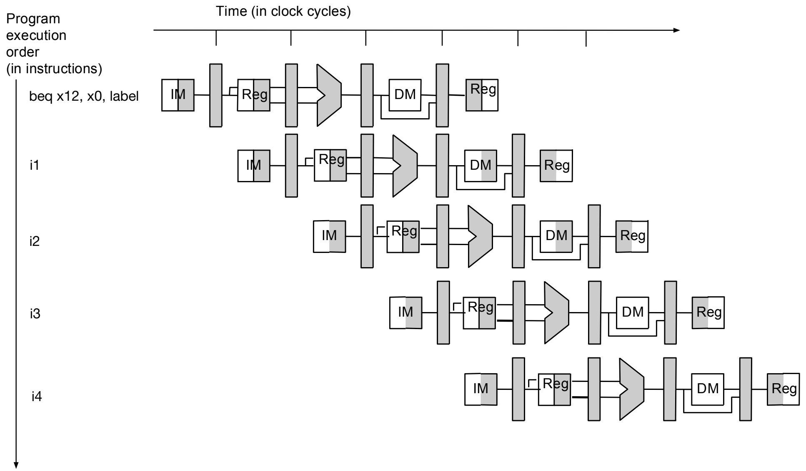
Control Hazards: Speculation
Predict: Always Taken
What do we need?
Target: NextPC
Needed in IF stage

Slide 8
Control Hazards: Speculation
Predict: Always Taken
How to obtain the branch target?
We can predict

Slide 9
Control Hazards: Speculation
When do we know the branch target?
Hard to computeConditional Branches: BEQ/BNE
PC = (R[rs1] ops R[rs2]) ? (PC + imm) : PC + 4
In ID stage
Prediction accuracy: High

Slide 10
Control Hazards: Speculation
When do we know the branch target?
Direct Jumps, Function calls: JAL
PC = PC + imm
In ID stage
Prediction accuracy: High

Slide 11
Control Hazards: Speculation
When do we know the branch target?
Indirect Jumps, Dynamic Calls, Returns: JALR
PC = R[rs1] + imm
After ID stage
Preduction accuracy: Low

Slide 12
Control Hazards: Speculation
How do we predict the address?
We need to track the history of previous branch targets
If a branch was visited before reuse its previous target
There is a chance it will execute the same path

Slide 13
Control Hazards: Speculation
Branch Target Buffer (BTB)
A table that stores branch targets
Indexable using the current PC
Why using the PC?

Slide 14
Control Hazards: Speculation
How BTB works?
Use PC to lookup the BTB
Found a match?
NextPC = BTB entry;
Otherwise
NexPC = PC + 4;

Slide 15
Control Hazards: Speculation
BTB implementation questions:
Where is BTB accessed?
How do we know that the current PC is a branch before accessing the BTB?
When do we update the BTB?
How do we update the BTB?

Slide 16
Control Hazards: Speculation
Where is BTB accessed?
NextPC is needed in IF stage
BTB should be accessed in IF stage

Slide 17
Control Hazards: Speculation
How do we know that the current PC is a branch before accessing the BTB?
Only branches are added into BTB
Make sure to clear BTB at startup

Slide 18
Control Hazards: Speculation
When do we update the BTB?
When we can compute branch target
In ID stage:
Add dedicated adder
JALR timing issue – register file access
In EX stage:
Add dedicated adder
No timing issue
Should be done in only one place
Why?

Slide 19
Control Hazards: Speculation
How do we update the BTB?
Check if branch
Calculate NextPC
Update BTB
BTB[PC] = NextPC

Slide 20
Control Hazards: Speculation
BTB Hardware Implementation
Implementing a hash table in H/W is expensive
Lookup area cost
Lookup latency
Table size must be small

Slide 21
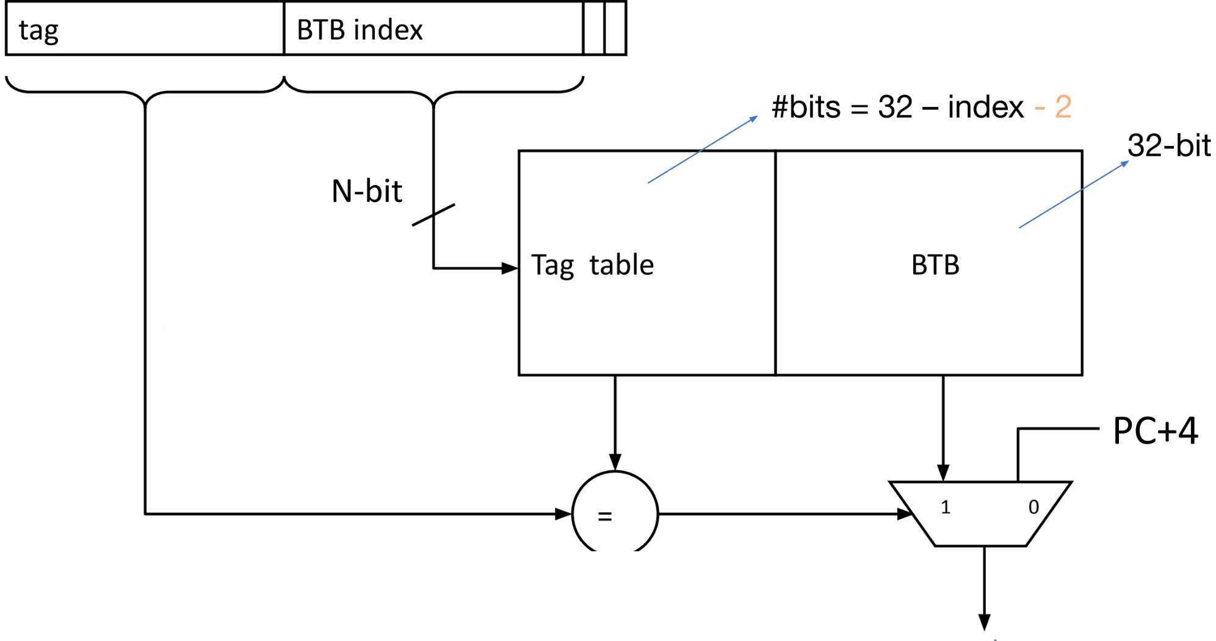
Control Hazards: Speculation
BTB Hardware Implementation
Use a Tagged-based Lookup table
Fixed size: btb_size
Indexing: btb_index
Lookup: btb_tag

Slide 22
Control Hazards: Speculation
BTB Hardware Implementation
PC address is 4-byte aligned
lower 2 bits are zero
Formulas:
index_bits = log2(btb_size)
pc_index = (pc >> 2) & index_bits
pc_tag = (pc >> 2) >> index_bits

Slide 23
Control Hazards: Speculation
BTB Hardware Implementation
Initialization:
Clear valid bit at reset
BTB lookup:
btb <= BTB[pc_index];
if (btb.valid == 1 && btb.tag == pc_tag) { PC = btb.target; } else { PC = PC + 4; }
BTB update:
BTB[pc_index] <= {1, pc_tag, target};
BTB hardware table
valid | tag | target
1 bit
26 bits
30 bits
16 entries

Slide 24
Control Hazards: Speculation
Improving Branch prediction
Predicting always taken is about 70% accurate
which is better than always not taken (30%).
How do we improve the prediction accuracy?

Slide 25
Control Hazards: Speculation
Code reordering optimization
If H/W implements static prediction
Not Taken or always Taken
Reorder code to prioritize predicted path
Pros/cons?
Pros: improved accuracy
Cons: architecture specific

Slide 26
Control Hazards: Speculation
BTFNT (Backward Taken, Forward Not Taken)
Loops usually have a few iterations, so this is like always predicting that the loop is taken
Loop back-edge => backward direction
Pros/Cons?
Pros: Improved accuracy
Cons: limited to loops only

Slide 27
Control Hazards: Speculation
Using a Branch predictor
Predict the outcome dynamically using the branch history
Recurring branches tend to repeat their pattern (e.g. loops)

Slide 28
Control Hazards: Speculation
One-Bit Branch Predictor
BTB entry hold a single bit: taken=1 or not_taken=0.
Index the table using lower K bits of PC
Update the table when the condition is resolved.
BHT: 2^K 1-bit entries
K bits of branch instruction PC
index
Use this entry to predict this branch:
0: predict not taken
1: predict taken

Slide 29
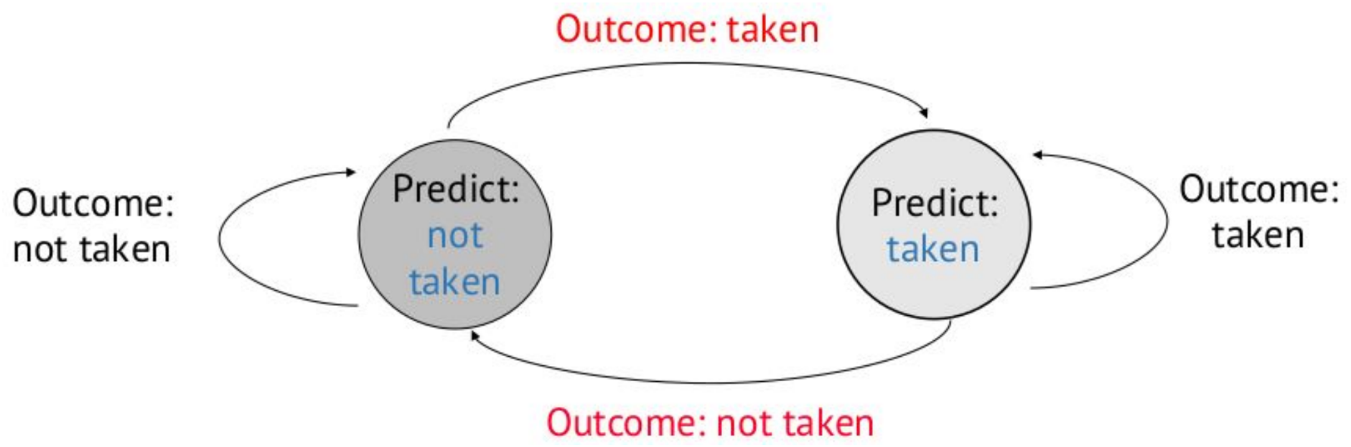
Control Hazards: Speculation
One-Bit Branch Predictor
FSM

Slide 30
Control Hazards: Speculation
One-Bit Branch Predictor
Examples
DC08: TTTTTTTTTTT ... TTTTTTTTTTNTTTTTTTTT…
100,000 iterations
How often is branch outcome != previous outcome?
2 / 100,000
99.9%
DC44: TTTTT ... TNTTTTT … TNTTTTT …
2 / 100
98.0%
DC50: TNTNTNTNTNTNTNTNTNTNTNTNTNTNT …
2 / 2
00.0%

Slide 31
Control Hazards: Speculation
One-Bit Is not enough!
Example: short loop (8 iterations)
Taken 7 times, then not taken once
Act: TTTTTTTNTTTTTTNTTTTTTTNT…
Pred: XTTTTTTTNTTTTTTNTTTTTTTN
Corr: XooooooMMooooooMMooooooMM
Misprediction rate: 2/8 = 25%
Execute the same loop again
First always mispredicted (previous outcome was not taken)
Then 6 predicted correctly
Then last one mispredicted again
Each fluke/anomaly results in two mispredicts per loop

Slide 32
Control Hazards: Speculation
Two-Bit Branch Predictor
Predict NT
Predict T
Transistion on T outcome
2
3
Transistion on NT outcome
0
1
0
1
FSM for Last-time
Prediction
FSM for 2bC
(2-bit Counter)
Smith, ISCA 1981

Slide 33
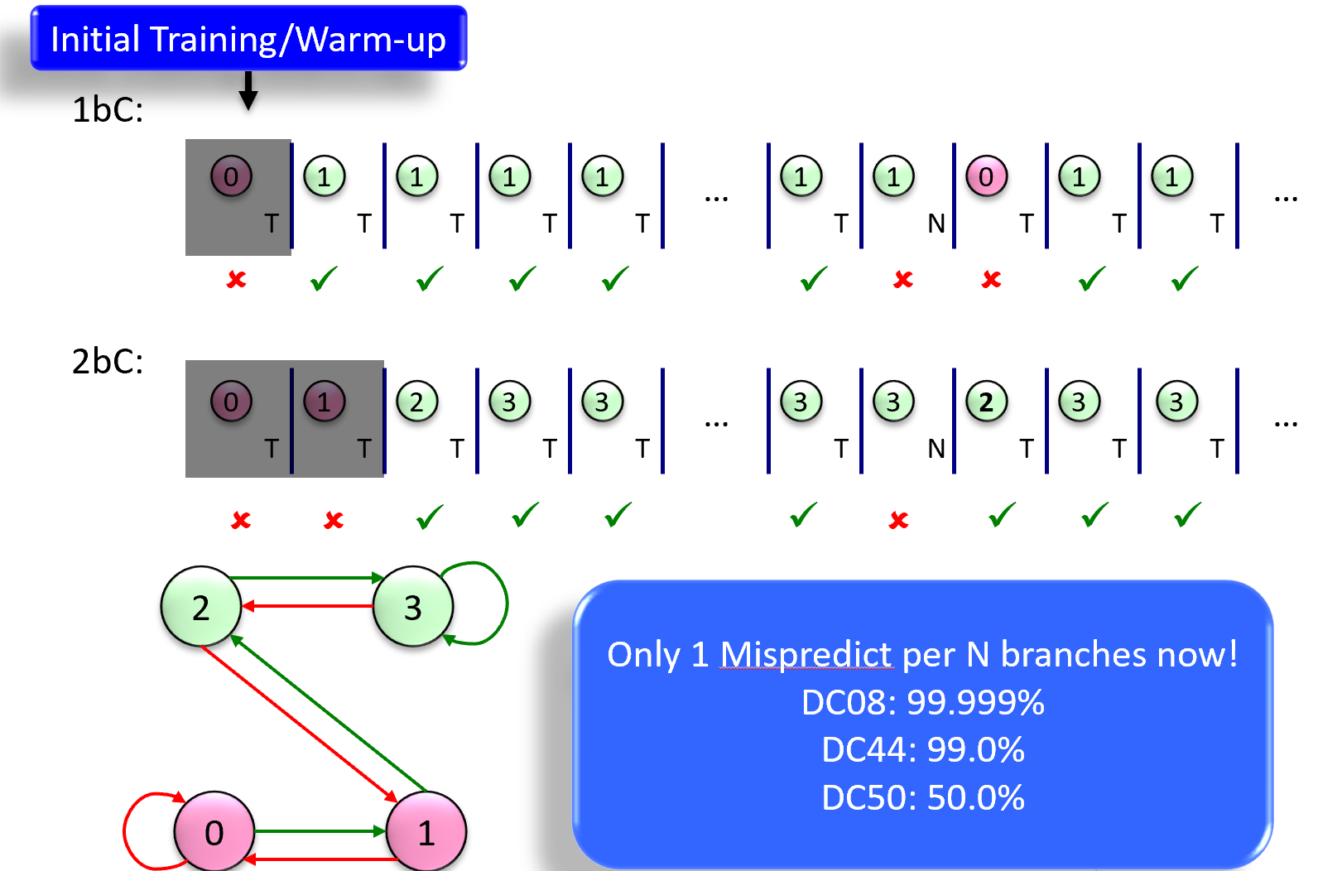
Control Hazards: Speculation
Two-Bit Branch Predictor

Slide 34
Control Hazards: Speculation
Can we do better?
1-BC and 2-BC predictors use last branch outcome to predict
Observation1: global branch correlation
The branch outcome is correlated with outcome from previous branches
Observation2: local branch correlation
The branch outcome is correlated with prior-outcome from same branch

Slide 35
Control Hazards: Speculation
Global branch correlation
Local branch correlation
if (cond1) { --//-- } if (cond1 and cond2) { --//--
}
for (x: 0 -> 1023) {
--//--
}

Slide 36
Control Hazards: Speculation
Two-level Branch Predictor
Level1: history of last N branches
Level2: last direction the branch took
2-Bit BHT
00 …. 00
Branch History Register (BHR)
index
2
3
1 1 ….. 1 0
1
previous one
0
1
00 …. 10
Yeh&patt’92
11 …. 11

Slide 37
Control Hazards: Speculation
Two-level Branch Predictor
Initialization value (0 or 1)
Past
Present
Example:
BHR 00000
Br1 : taken → BHR 00001
Br2: not-taken → BHR 00010
Br3: taken → BHR 00101
0 0 0 0 0 0
1 : branch is taken
0: branch is not-taken
History length
New BHR = old BHR<<1 | (br_dir);

Slide 38
Control Hazards: Speculation
Two-level Branch Predictor
Branch X: if (cond1)
Branch Y: if (cond 2)
Branch Z : if (cond 1 and cond 2)
BHT
BHR
…….1 0
…….1 1
Branch X | Branch Y | Branch Z
1 | 0 | 0
1 | 1 | 1
0 | 1 | 0
0 | 0 | 0
…….01
…….00

Slide 39
Control Hazards: Speculation
Gshare Branch Predictor
Different branches may see the same history but have different outcome
Need additional context
2bc
2bc
BHR
1 1 ….. 1 0
index
XOR
2bc
PC
0x809000
Predictor size: 2^(history length)*2bit
McFarling’93
2bc

Slide 40
Control Hazards: Speculation
Gshare Branch Predictor: algorithm
predict_func(pc, actual_dir) { index = PC xor BHR taken = (2bit_counters[index] >= 2) ? 1 : 0 correctly_predictied = (actual_dir == taken) ? 1 : 0 // stats }
update_func(pc, actual_dir) { index = PC xor BHR if (actual_dir) INC_SAT(2bit_counter[index]) else DEC_SAT(2bit_counter[index]) BHR = BHR << 1 | actual_dir }

Slide 41
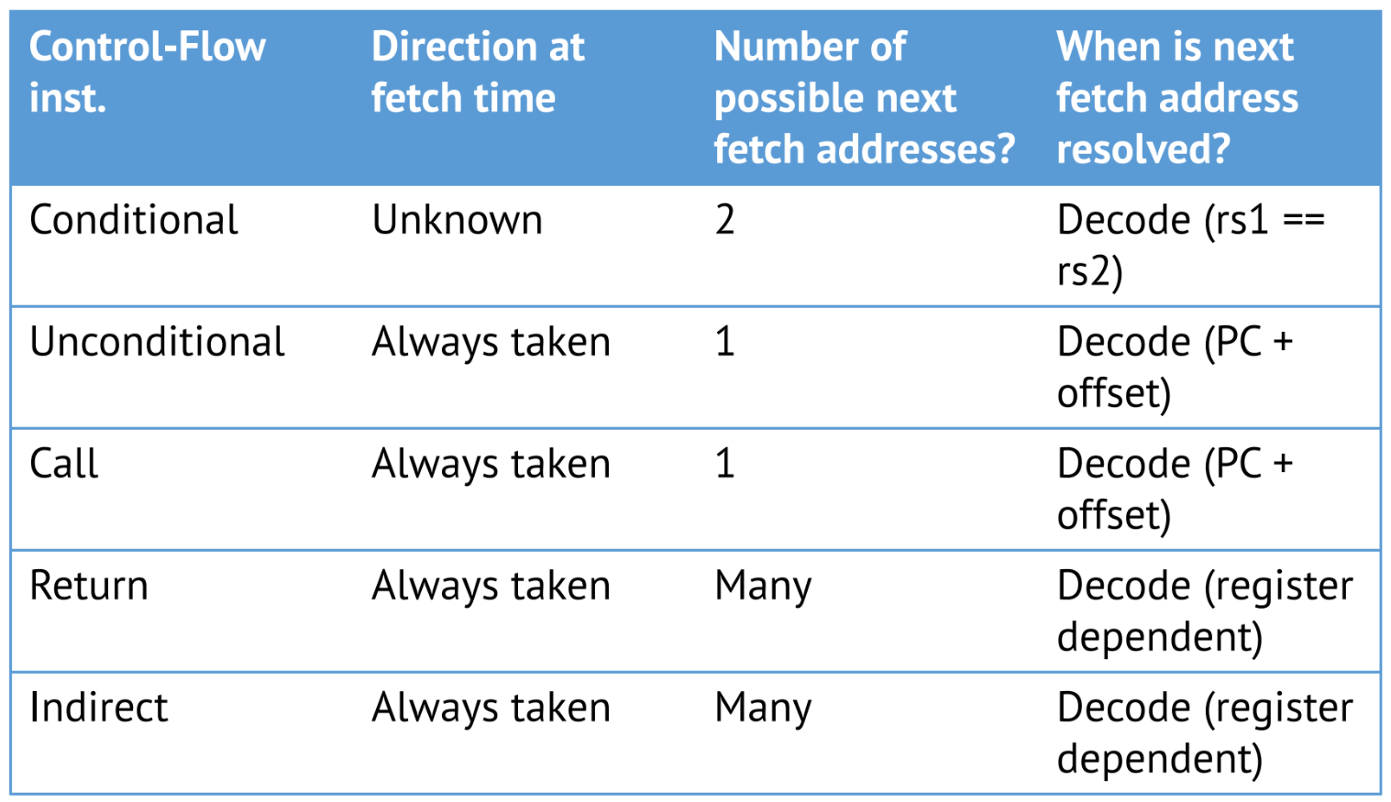
Control Hazards: Speculation
Improving Return Call Prediction
RISC-V JALR
PC = R[rs1] + imm
Target dependents on rs1

Slide 42
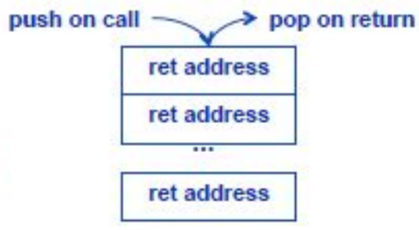
Control Hazards: Speculation
Return Stack Buffer (RSB)
Use hardware stack
About 4-8 entries
On function call:
Push current return address
On function return:
Pop last return address
Use that for prediction

Slide 43
Control Hazards: Speculation
Return Stack Buffer (RSB)
Tail recursion optimization
if (stack.top == ra) => skip
Integration with BTB:
Predict NextPC from BTB or RSB
How to choose?
Extend BTB with “isRA” column

Slide 44
Project #1

Slide 45
Project #1
Deadline: Next week
What to do:
decode & execute
data forwarding – handle stall cases
3 cycles stall on branches
Help:
README has a lot of info
TA|me office hours

Slide 46
Q&A

Slide 47
Acknowledgement
This course is partly inspired and use materials from the following courses created by my colleagues:
ECE-M1126C: Nader Sehatbakhsh @ UCLA
CS3220: Hyesoon Kim @ gatech

